Slide 1
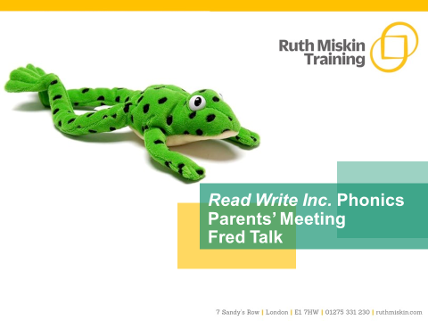

Slide 2
What is phonics?
Sounds
Graphemes
Parent video: How to say the sounds - YouTube
Notes:
All words are made up of individual sounds. These sounds are merged together to form words.
e.g. in ‘mat’ we have the sounds ‘m’, ‘a’, ‘t’, ship – ‘sh’, ‘i’, ‘p’.
Click A grapheme is another name for the letters we use to write the sound. The spelling of that sound on the page.
Phonics is the method of teaching reading through the identification of sounds and graphemes.
The new National Curriculum ensures that all children are taught Phonics systematically.
This gives your children the tools to read any word.

Slide 3
Speed Sounds Set 1
Notes:
Remember that:
- Children need to know sounds – not letter names – to read words.
- We pronounce the sounds clearly, using pure sounds (‘m’ not’ muh’, ’s’ not ‘suh’, etc.) so that your child will be able to blend the sounds together to make words more easily.

Slide 4
Speed Sounds Set 2
Notes:
Set 2 sounds are shaded. They are long vowel sounds with 2 or more letters. We call these ‘Special Friends’ – two letters together that make one sound.
Let’s practise saying these sounds together.
Say each sound MTYT.
Once children know these Set 2 sounds, they know one way of reading and writing every sound.

Slide 5
Speed Sounds Set 3
Notes:
Once children know how to read Set 2 sounds, they start to learn Set 3 sounds.
These are shaded in the chart.
They are alternative graphemes (spelling of a sound) for the Set 1 and Set 2 sounds the children already know.
Point to the chart to show. For example, they know ‘ay’ and now learn a-e and ai as other spellings for the same sound.

Slide 6
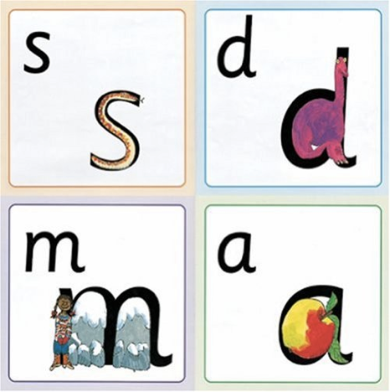
Name the pictures
Notes:
We give children a hook to learn the sounds by using pictures in the same shape as the letter.
‘s’ looks like a snake.
‘d’ looks like a dinosaur.
‘m’ looks like a mountain.
‘a’ looks like an apple.
We teach the children to name the mnemonic pictures before they learn the sound.
This means that children learn to read and write the sounds really easily.

Slide 7
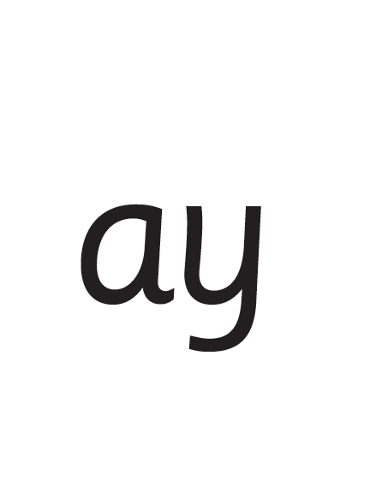
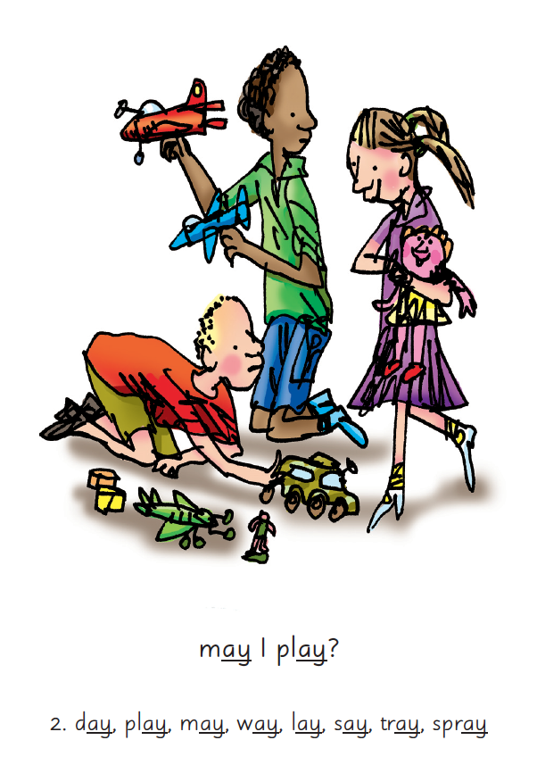

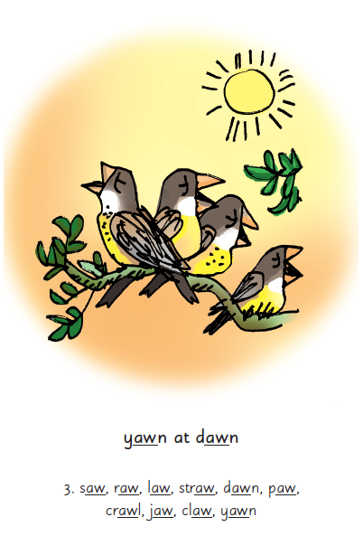
Picture Phrases
Notes:
We use picture phrases to help children remember the Set 2 and Set 3 sounds.
For example, ay, may I play? aw, yawn at dawn

Slide 8
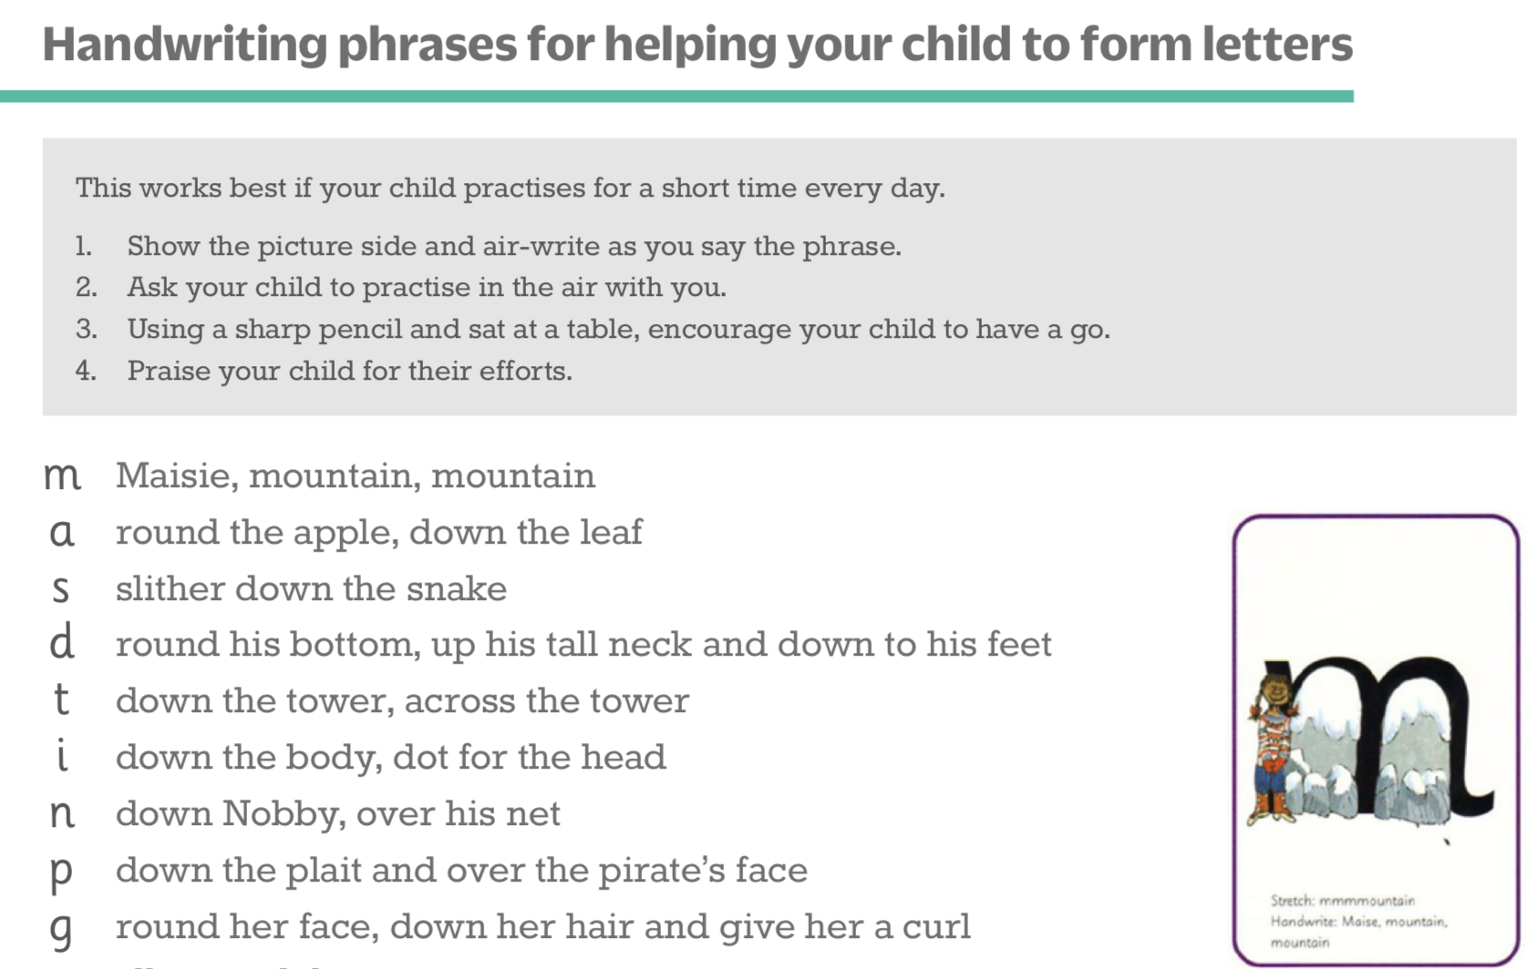
Teaching letter formation
Notes:
Children use the picture mnemonic to learn to form letters correctly at the same time they learn to read each sound.
Each sound has a handwriting phrase e.g. down Maisie, and over the mountains.
Use these handwriting phrases when practising writing at home with your child.
Avoid using these to read the sound.
I will give you a handout of these handwriting phrases when you leave today.

Slide 9
What can I do?
1. Use pure sounds, not letter names
2. Teach the picture names
3. Practise reading sounds speedily -
‘review, review, review’
4. Use the handwriting phrases for writing only
Notes:
Show how to use ‘My Set 1 Speed Sounds Book 1’ or cards if you send these home.
You can purchase Set 1 flashcards or My Reading and Writing Kit ages 3-5 early sounds and blending to support your child with Set 1 sounds at home.

Slide 10
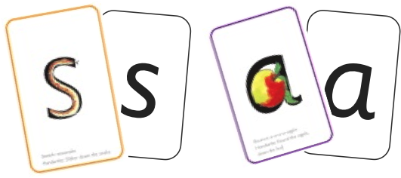

Sounds + blending = reading
+
Notes:
Today I want to help you understand how your child is learning to read words in Read Write Inc. Phonics by blending sounds together:
Alongside teaching children sounds, we teach them to blend sounds to read words e.g. s-a-t, sat.
We use Fred Talk to help children read.

Slide 11




Reading with Fred Talk
Notes:
We teach children to read words using Fred Talk to blend together the sounds they know e.g. m-a-t, mat.
We say ‘Fred Talk, read the word’.

Slide 12


‘Special Friends’, ‘Fred Talk’, read the word
Notes:
Then children practise reading these sounds in words using the routine ‘Special Friends’, ‘Fred Talk’, read the word’.
They spot the ‘Special Friends’ first, then Fred Talk to read the word.
For example, ‘ay’, s-p-r-ay, spray.

Slide 13
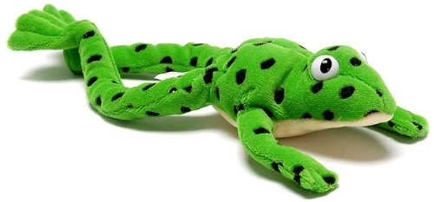
Fred Talk routine
Say the word in sounds as Fred e.g. c-a-t.
Ask your child to repeat. Can they ‘jump-in’ with the whole word?
Say the word in sounds followed by the whole word e.g. c-a-t, cat
Ask your child to repeat
Notes:
Fred Talk follows a consistent routine:
Say the word in sounds as Fred e.g. c-a-t. Ask children to repeat. Pause to allow children to ‘jump-in’ with the whole word.
Say the word in sounds followed by the whole word e.g. c-a-t, cat. Ask children to repeat.

Slide 14
Fred games and Fred talk throughout the day
l
-u
?
Shall we have some
What would you like to
Let’s put on your
-ch
-n
-ay
-l
p
?
-oa
-t
c
.
Notes:
Try to use Fred Talk throughout the day at home to help your child practise blending sounds together.
Fred Talk words at the end of the sentence and keep the words short and simple.
With the person next to you, have a practise of the three sentences on the screen.
Remember to Fred Talk the last word of the sentence.
You can also play Fred Games with your child at home. I will show you one of these in action in a moment,

Slide 15
Read Write Inc. Phonics
Parents’ Meeting
Listening to your child read
Notes:
Approximately 20 minutes is needed for this session.
Notes are provided to help you lead the presentation.
Notes in italics are for your attention only.
Provide copies of ‘Reading at Home Booklet 1 or 2’ from Oxford Owl.
Booklet 1 is sound groups and Ditty/ Red Groups and Booklet 2 for Green – Grey Storybooks.
Children will make the best possible progress if they read as often as possible.
Today we are going to discuss how to listen to your child read their Read Write Inc. Phonics decodable storybook when they bring it home.

Slide 16
‘Three with me, four at home’
Accuracy
Fluency
Comprehension
Read and enjoy at home
Notes:
In our school, children read each Read Write Inc. Storybook three times in class with their partner.
Re-reading the same book helps children to become confident readers. Each time they re-read, they build their fluency/speed and comprehension.
They love reading and want to read because they can read all of the words in the Storybook.
We set a focus for each re-read in school.
(Click) The first read focuses on reading every word accurately.
(Click) The second on reading the story more quickly.
(Click) The third read on comprehension - understanding what they read.
Then your child brings the same book home to read and enjoy with you again and again at home.
It’s ‘three with me, four at home.’
We do not send stories home the children cannot read because we always want them to be set up to succeed in their reading.
We want to make sure they enjoy reading so that they want to read.
The more they read, the faster progress they will make.

Slide 17

After the third read…
Notes:
So after the third read in class, children bring the same Storybook home in their book bag.
They love this book!
They can read it like a storyteller and can’t wait to read it to you, their grandparents or even their teddy bear.
Please avoid saying, “This book is too easy for you!” but instead say “I love how well you can read this book!”
They are meant to be able to read all of the words as the book is at the correct level.
Encourage them to share their enjoyment of the story with you and read it in their storyteller voice – again and again.

Slide 18

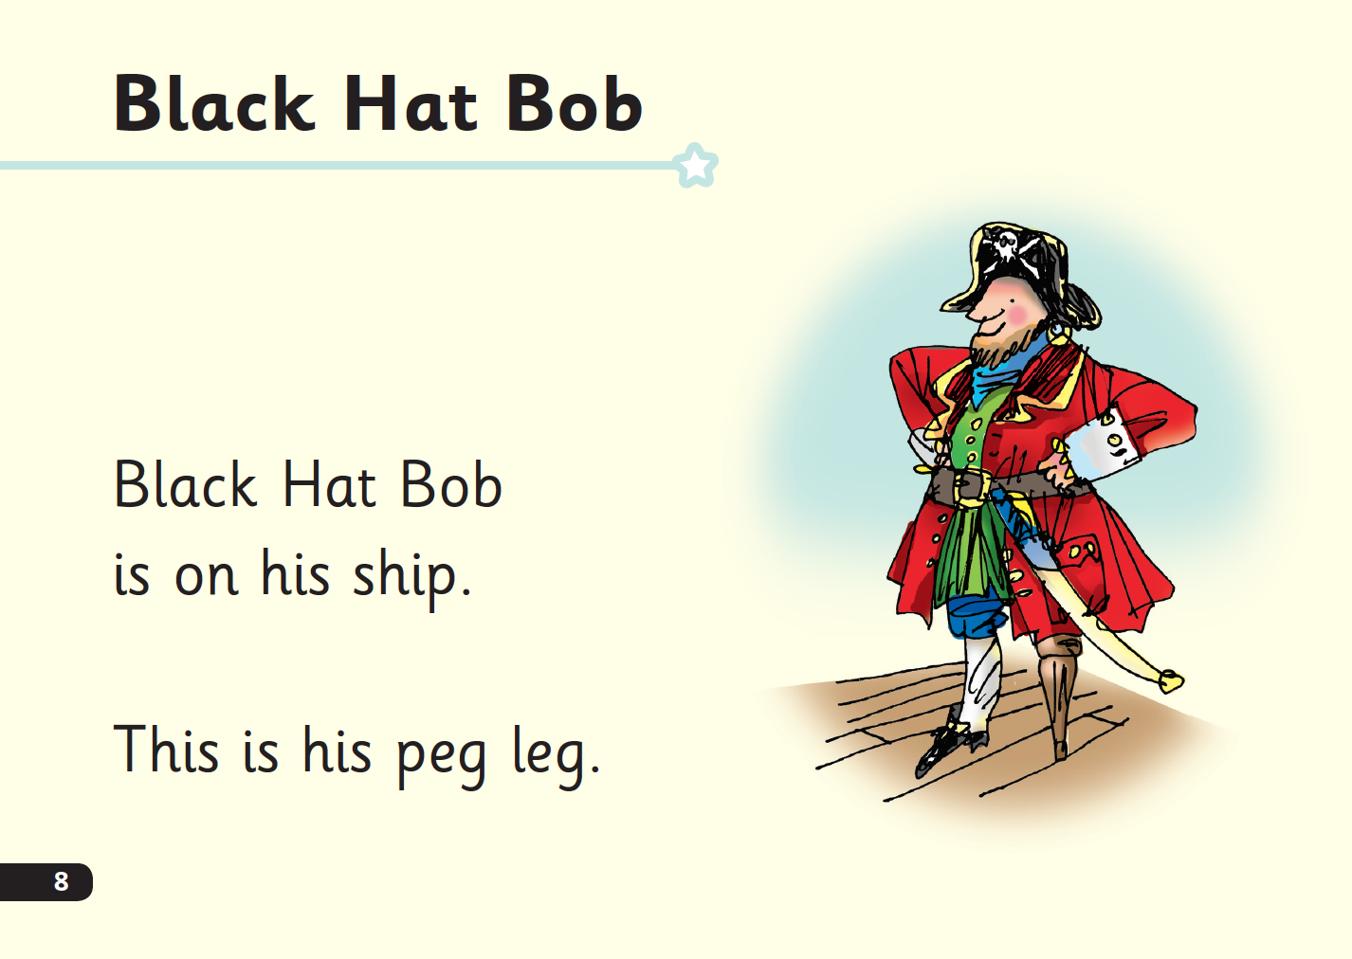
‘Special Friends’, ‘Fred Talk’, read the word
Notes:
E Children will be able to read all of the words in the Storybook.
If they hesitate, remind them to read the word using ‘Special Friends, Fred Talk, read the word’.
For example, this means they spot the ‘sh’, then Fred Talk and blend to read the word e.g. sh, sh-i-p, ship.

Slide 19

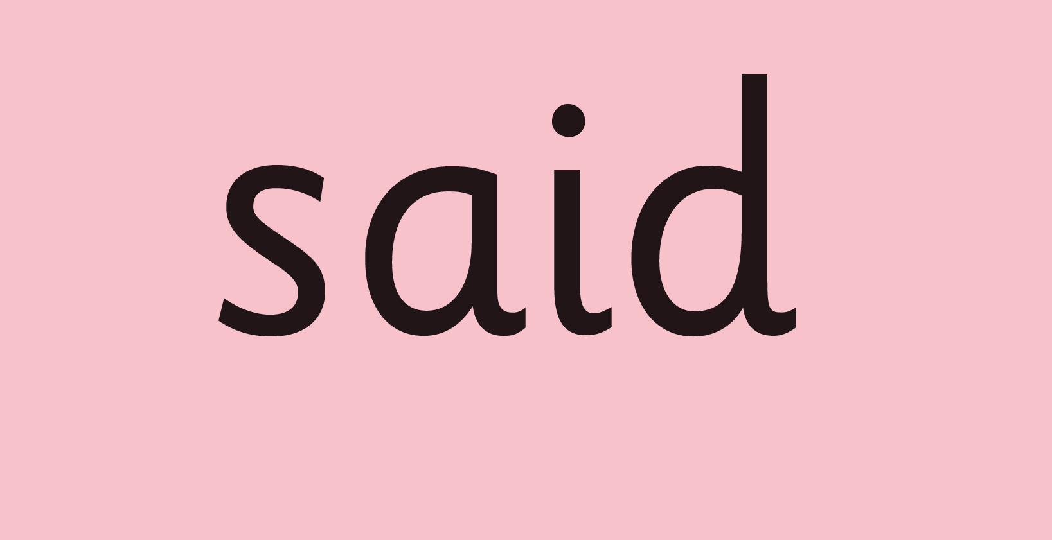
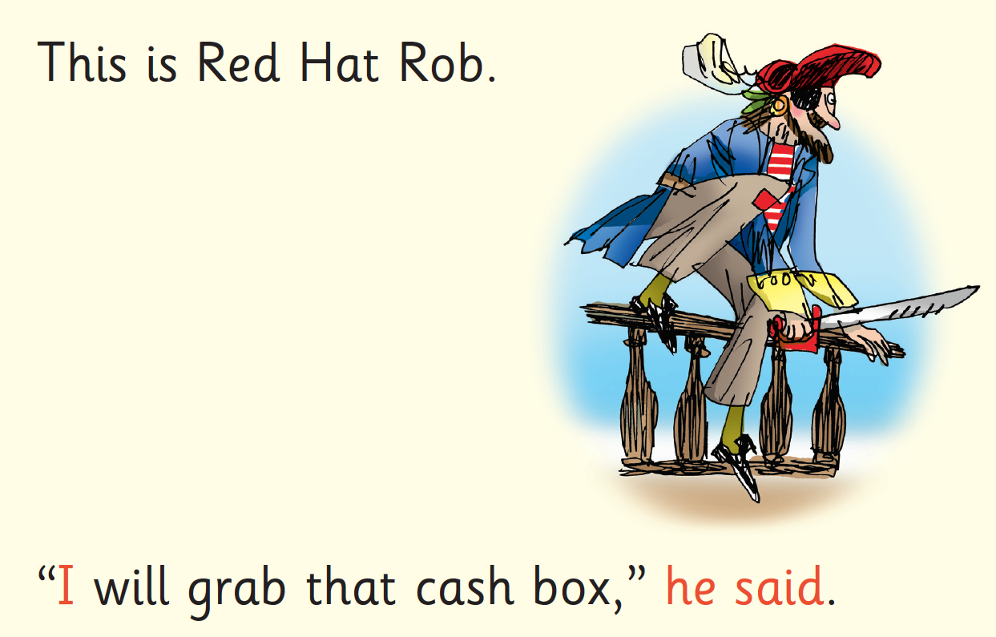
Red Words
Notes:
Some words are ‘tricky’ because they contain letters that don’t match the sounds the child has been taught.
For example, ‘said’ has ‘ai’ making an ‘e’ sound.
We teach these common exception words as Red words.
In the early Storybooks, these words are printed in red text.
Remind your child not to use Fred Talk to read Red words but instead to stop and think. Tell them the word if needed.

Slide 20


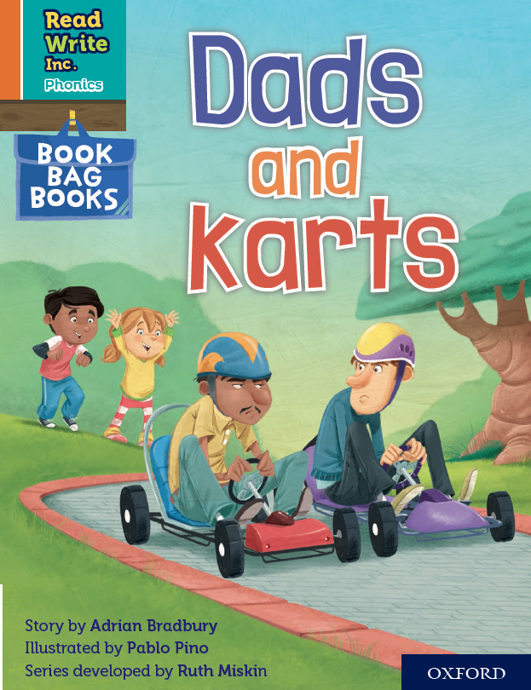

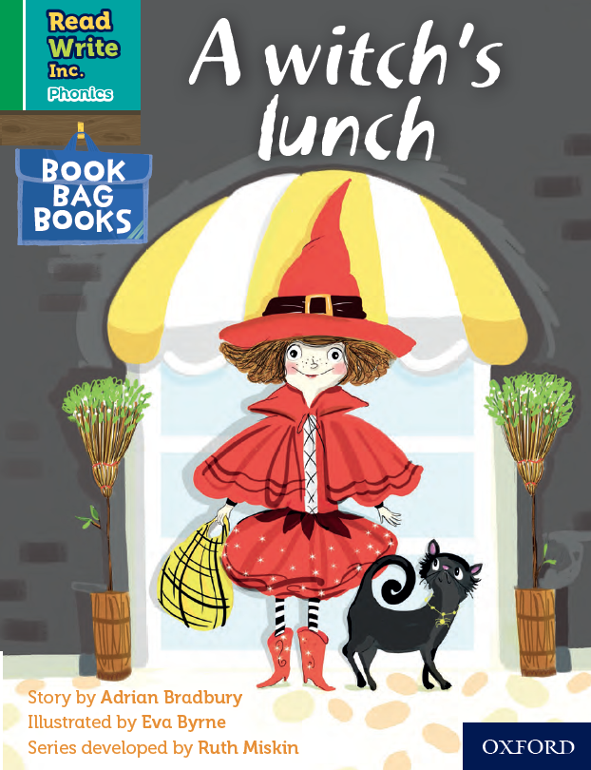
Book Bag Books
Extra reading practice at home
Uniquely matched to the Read Write Inc. Phonics Storybooks.
Reinforce children's learning of phonics at the appropriate level.
Helps to make even faster progress in reading.
Notes:
Only use this slide if you use Book Bag Books in your school.
We use Book Bag Books especially for home reading. They have guidance inside just for you as parents.
They are matched to the books children read in school so provide practice of the same sounds – extra practice at the right level for your child.
They include many of the same reading activities that we use in class.

Slide 21
What can you do?
Listen to your child read the same Storybook again and again
Encourage them to use ’Special Friends’, ‘Fred Talk’, ‘read the word’
Discuss the story and encourage their storyteller voice.
Notes:
Provide copies of ‘Reading at Home Booklet 1 or 2’ from Oxford Owl.
Booklet 1 is sound groups and Ditty/ Red Groups and Booklet 2 for Green – Grey Storybooks.

Slide 22


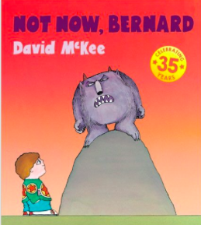

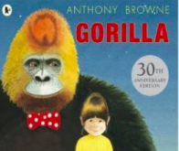
Repeated readings
Again! Again!
Children are wired to thrive on repetition
Notes:
Stories provide a wealth of language we don’t use in everyday talk.
The more stories, poems and nursery rhymes children know well, the more easily they will be able to understand what they read, when they can read.
Children thrive on repetition.
Take Sophie who is 2 ½ years old.
She begs for her favourite stories to be read over and over again.
The more her mum repeats the story, the more the story ‘belongs’ to Sophie.
Sophie ‘reads’ it, copying the special emphasis and actions that her mum used every time she read the story to her.

Slide 23
10 things your child learns when you read aloud stories and poems every day
Sustain attention
Appreciate rhythm and rhyme
Build pictures in their minds from the words on the page
Understand humour and irony
Use new words and phrases in different contexts - and later in writing
Learn new vocabulary and knowledge of the world
Think about characters’ feelings and use appropriate voices
Follow a plot with all its twists and turns
Understand suspense and predict what’s about to happen next
Link sentences and ideas from one passage to the next
Notes:
Look at all these things you child will learn when you read aloud stories and poems, - without any teaching!
Click each point and read.

Slide 24
Read Write Inc. Phonics
Parents’ Meeting –
Phonics Screening Check
Notes:
Approximately 10 minutes is needed for this session.
Notes are provided to help you lead the presentation.
Notes in italics are for your attention only.

Slide 25
What is the Phonics Screening Check?
A word-reading test at the end of Year 1
Children read 40 words
Notes:
Children complete a word-reading check at the end of Year 1 so that parents can be confident their children are being taught to read successfully.
Children read 40 words. It takes between two and five minutes.
If they do not manage to read 32 of the words, they are given extra support, and repeat the check at the end of Year 2.
It means that all children will be able to read accurately before they begin Year 3.
In our school, we aim to make sure that every child learns to read accurately by the end of Year 1 so they are set up for success in school and in life.
As soon as we spot a child who needs extra practice learning to read sounds and words, we teach them one-to-one for a few minutes every day.

Slide 26
‘Special Friends’, ‘Fred Talk’, read the word
Notes:
We teach children to read both real and nonsense words using the routine ‘Special Friends’, ‘Fred Talk’, read the word’.
Children spot the ‘Special Friends’ (two letters that make one sound), Fred talk the word, and then read the word as a whole.
For example, ‘sh’, sh-i-p, ship.

Slide 27



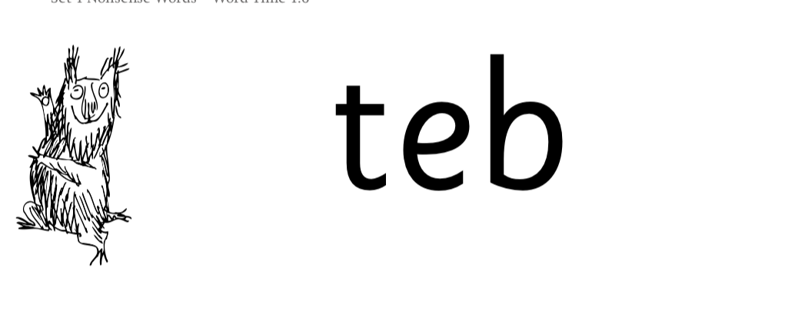
Nonsense words
Notes:
Half of the words in the check are real words.
Half are nonsense words. For example, ‘sheb’, ‘glight’, ‘ched’, ‘teb’.
There is a picture of an alien next to each word to remind the children that it isn’t a real word.
Nonsense words check that children will be able to read sounds they know in unfamiliar words.
Children who can read nonsense words will, very soon, be able to read any new word – for example – gargantuan, flailing, raucous, anticipation;
Reading new words increases children’s vocabulary rapidly.

Slide 28
What happens after Read Write Inc?
The children will take part in RWI Comprehension – with a focus on fluency and comprehension.
Children will go onto book banded books (different to RWI books)
All KS1 children (Year 1 and year 2)
All Year 1 and Year 2 children will take part in whole class reading session once a week.
Focusing on reading VIPERS – in preparation for Year 2 SATS.

Slide 29
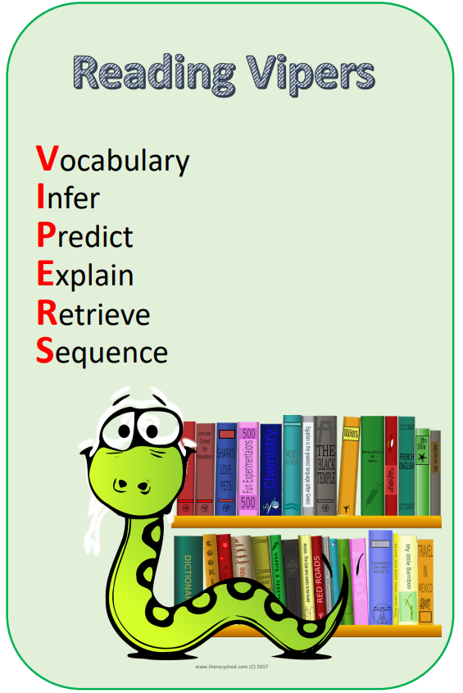
Reading VIPERS
Targeted questions based around the VIPERS

Slide 30
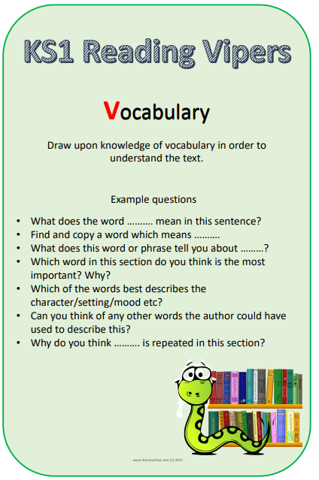
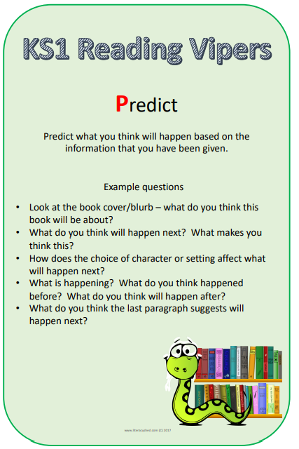
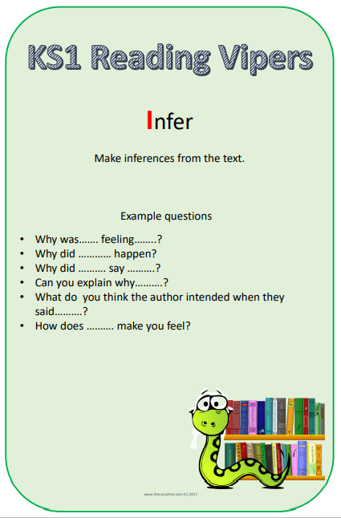
Reading VIPERS
Targeted questions based around the VIPERS

Slide 31
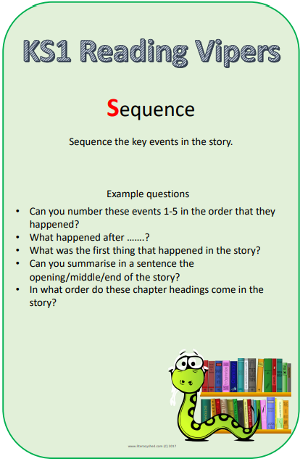
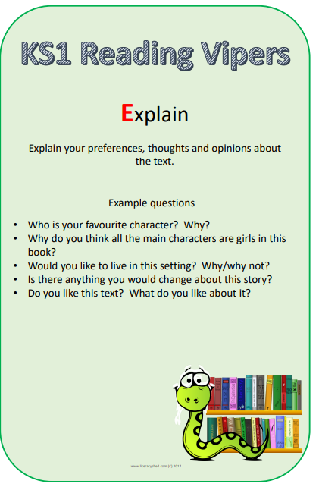
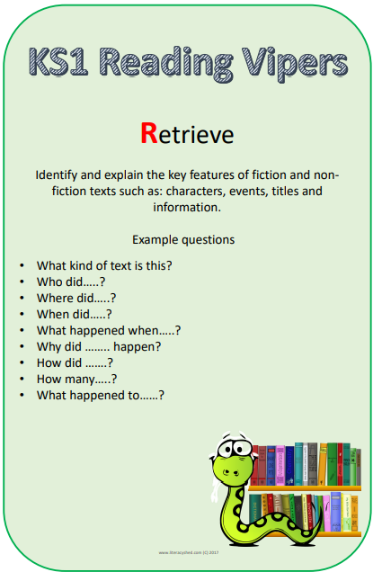
Reading VIPERS
Targeted questions based around the VIPERS

Slide 32
The more that you read, the more things you will know. The more that you learn, the more places you’ll go!
Dr. Seuss
Notes:
In the words of Dr Seuss…read quote.
Good readers do well in school – and in life.
By listening to your child read, you are making sure they have the opportunity to practise and become a good reader quickly.
Remember that all parents have the power to change outcomes for their children.

Slide 33
Online resources available
Ruth Miskin Parents’ Page:
http://www.ruthmiskin.com/en/parents/
Ruth Miskin Facebook:
https://www.facebook.com/miskin.education
Read Write Inc – Flintham Primary School

Slide 34
Any other questions
Q&A

