Slide 1

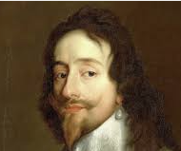
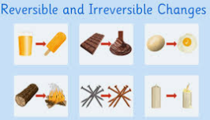
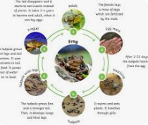
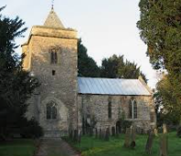
Earth Class
Autumn Term
2025/26
Civil War and Local Geography: Flintham
The children will find out about the civil war and conducting fieldwork in the local area.
Topic Key Events & Curriculum Links
History: Civil War
Geography: Local area fieldwork (Flintham).
Science: Materials (including reversible and non-reversible changes) and Animal life cycles
Computing: Coding & Graphic Design
Art/DT: Crime and punishment Shakespeare portraits & Mechanisms PSHE: Me and my relationships & Valuing difference
RE: Exploring the New Testament & Journey Through Life
PE: Swimming, Rugby, Hockey & Striking and Fielding
MFL: The fable of Le corbeau et le renard (The crow and the Fox) & Food and Christmas in France
Music: Hey Mr Miller, Shadows and Composing for protest
Topic Overview
Our History topic this half term is the Civil War. The children will look at when the Civil War occurred and who Charles I was. They will then focus on what role Newark played during the Civil War which will include a visit to the Civil War Museum. After half term, we will move on to our Geography topic: Skills and fieldwork in Flintham. This topic will involve children completing various fieldwork around the local area, including studying local maps, visiting areas around Flintham and undertaking fieldwork. Our Science topic this half term is properties and changes of materials. During this topic we will be looking at reversible and irreversible changes and if all substances can be mixed and separated. After half term we will move on to animal life cycles. In this topic the children will learn about the different types of lifecycles for different animals.
Topic Outcomes
By the end of the topic the children will have a good understanding of why Newark was so important in the civil war. They will look at a range of primary and secondary sources and use timelines to help them understand this. They will be able to use maps and symbols to locate places around Flintham and will be able to understand the difference between human and physical features. Children will also be able to compare and group materials based on their properties and will understand reversible and irreversible changes through conducting a range of experiments. They will also be able to make predictions and conduct fair tests.
Useful Information
Swimming is every Thursday morning. The last swimming lesson is on Thursday 11th December.
PE days are Wednesday and Thursday. Children will be having a rugby session every Thursday afternoon until half term. Please send your child in their PE kit on a Wednesday and Thursday and also remember their swimming kit on a Thursday as well.
Please make sure earrings are removed and children are in their PE kits (white t-shirt, black jogging bottoms and school jumper) with a spare pair of shoes in case they get muddy.
Please continue to read with your child at home and record in the reading log. Reading regularly makes a huge difference to your child’s progress in school.
Children should also be accessing TT Rockstars and Spelling Shed at home weekly, and this is checked by teachers. There are opportunities in school for your child to complete this if it is not possible at home.
How you can help
If you have any old photographs of Flintham we would love to see these! If you are happy for these to be shared in class please bring them in after October half term.

