Slide 1

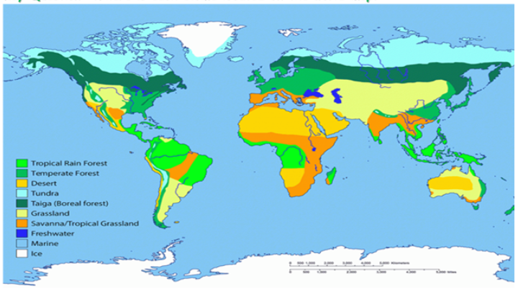
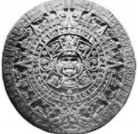
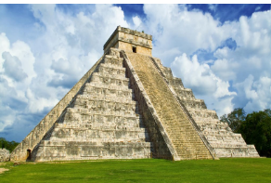
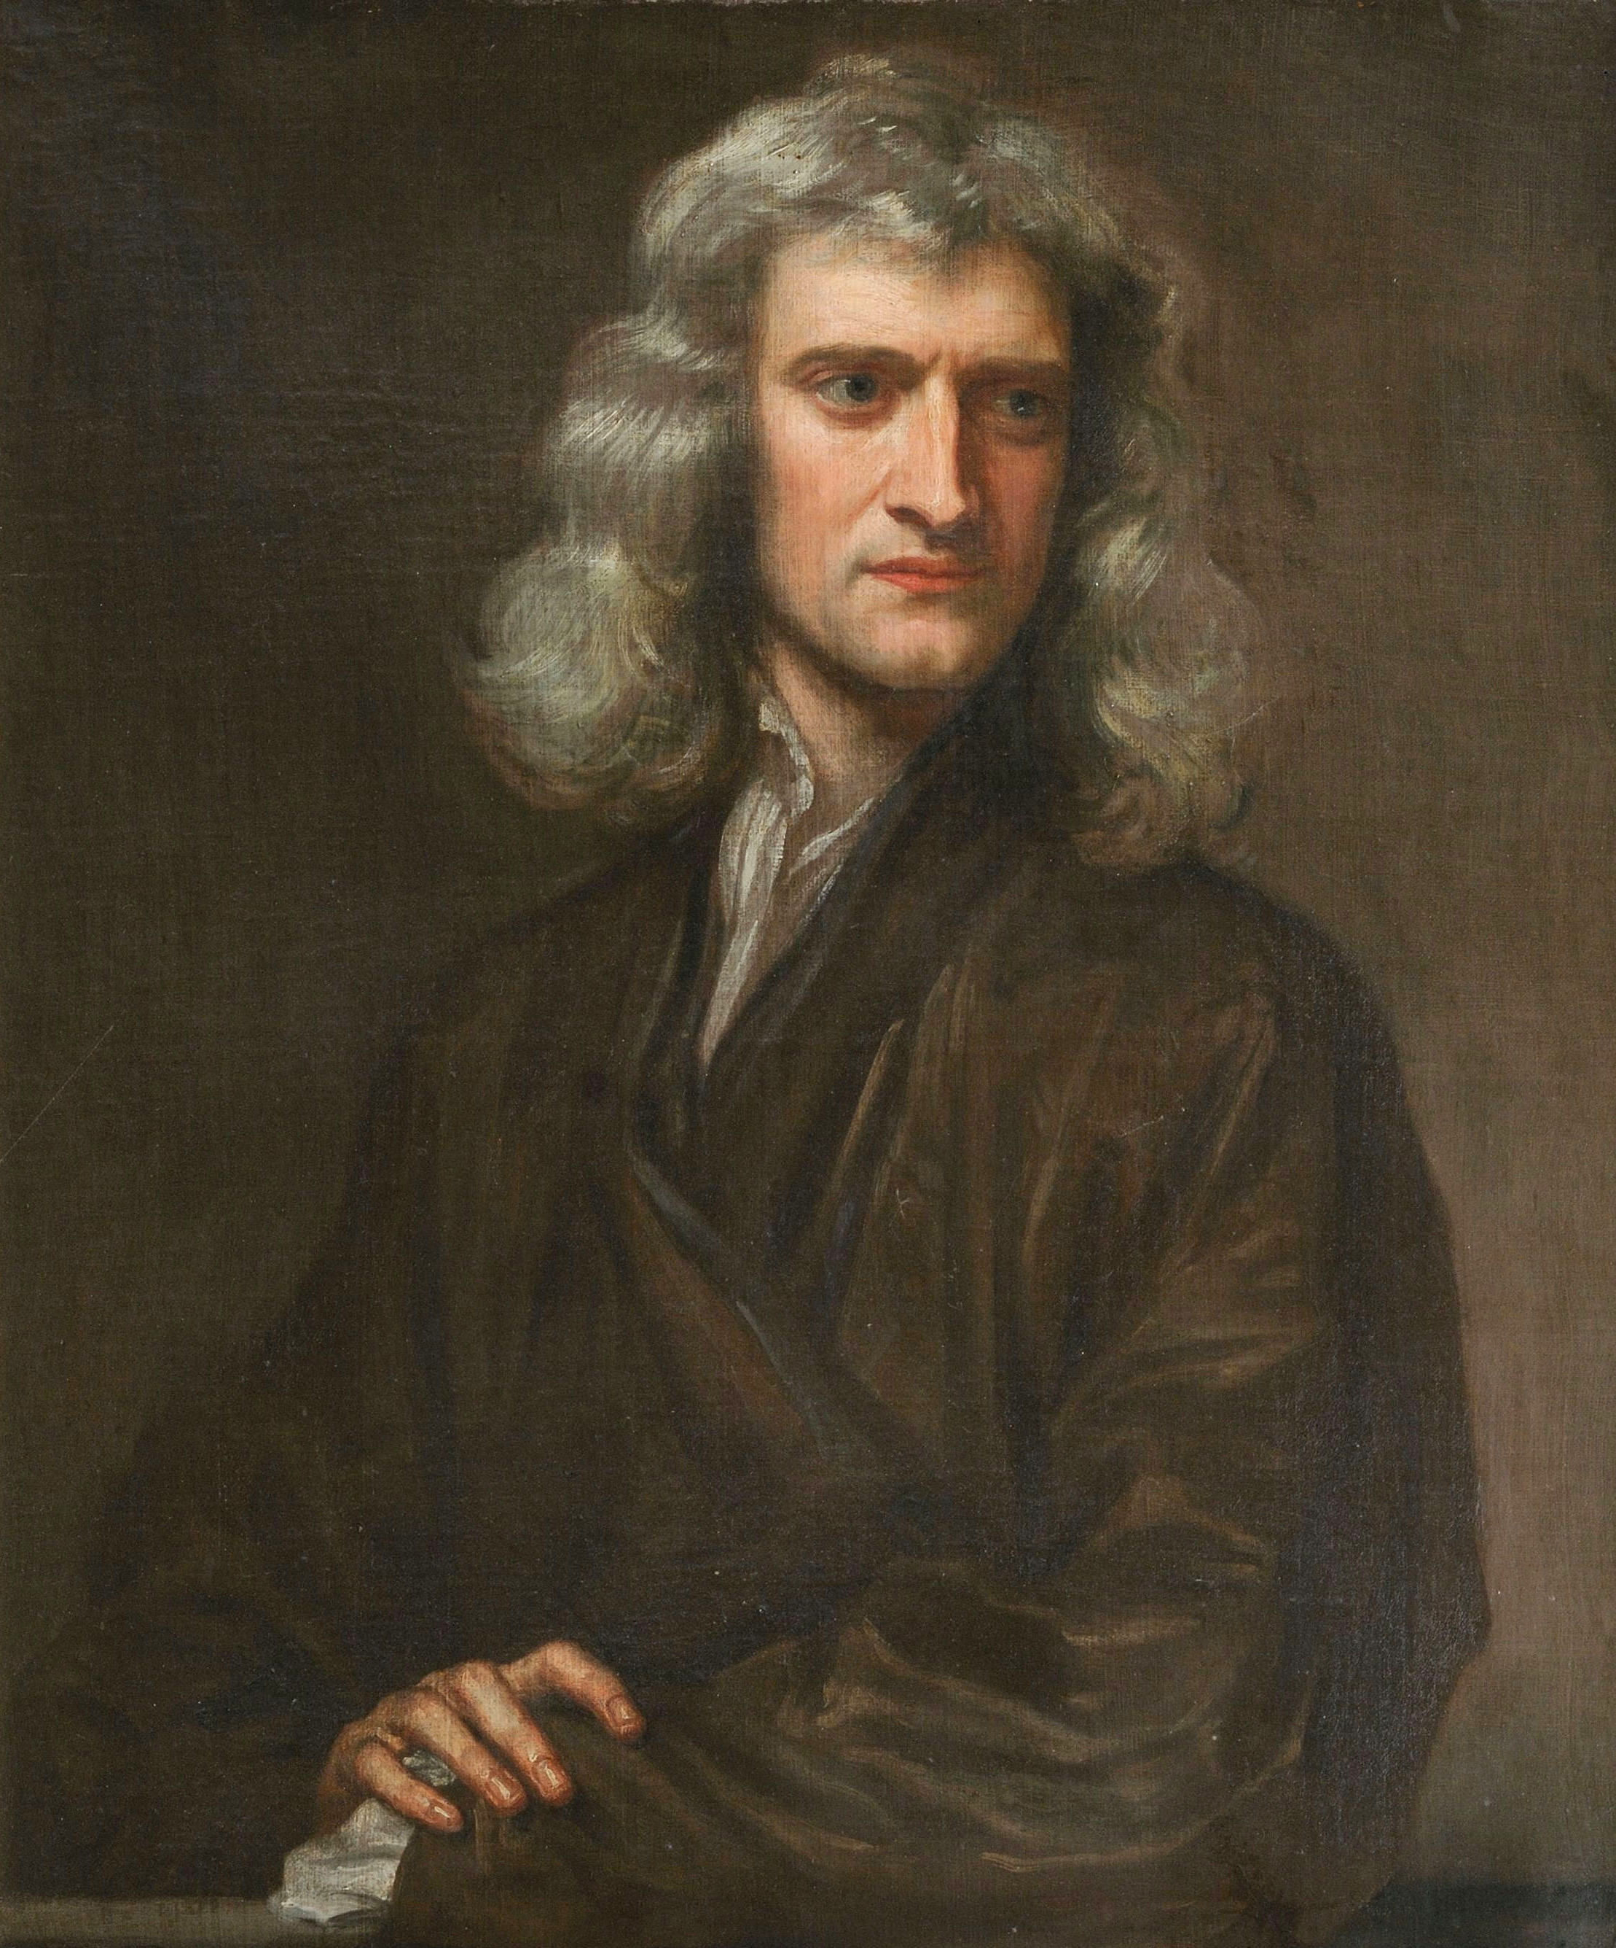
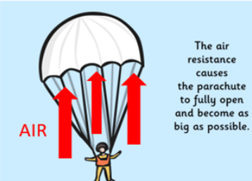
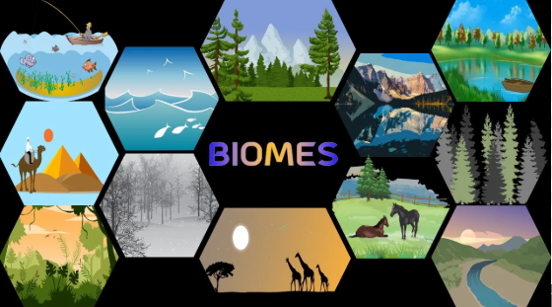
Earth Class
Spring Term
2025/26
Biomes and The Mayans
The children will find out about the biomes of the world and study The Mayans
Topic Key Events & Curriculum Links
Geography: Biomes
History: The Mayans
Science: Forces & Outdoor Exploring (Forest School)
Computing: Coding programming & Word processing e-book creation
Art/DT: Paul Klee rod puppets & Mayan pyramid structures PSHE: Keeping myself safe & Rights and Responsibilities
RE: Making a difference & Muslim Families and Celebrations
PE: Dodgeball, Dance, Netball, Gym/Yoga
MFL: Jobs and future plans, Mardi Gras and Alice in Wonderland Music: Dona nobis pacem & Ain’t gonna let nobody
Topic Overview
During Geography this term the children will learn all about biomes. They will be able to locate biomes on a world map and research characteristics of these. The children will also look at how humans impact biomes. After half term we move on to History and will study the Mayans. We will look at the structure of the Mayan civilisation and understand how the Mayans lived. In Science we will be learning all about Forces! There will be a trip to support learning to the RAF Syerston and parents/carers will be notified of the date in due course. After half term we will move on to Forest School. This will give the children lots of opportunities to get outdoors to study various aspects of Science such as hunting for micro-organisms, exploring variation and adaptation over time using trees and planting seeds.
Useful Information
PE is on a Tuesday and Wednesday. Please make sure earrings are removed where possible or covered and children are in their PE kits (white t-shirt, black jogging bottoms and school jumper) with a spare pair of shoes in case they get muddy.
Please continue to read with your child at home and record in the reading log. Reading regularly makes a huge difference to your child’s progress in school.
Children should also be accessing TT Rockstars and Spelling Shed at home weekly.
Topic Outcomes
By the end of the topic children will be able to name and locate the Earth’s biomes. They will be able to name characteristics of biomes and understand the impact humans have on them. They will be able to explain who the Mayans were, what they believed in and the decline of their civilisation. In Science, children will be able to understand what a force is, explain gravity, friction, air and water resistance and understand who Isaac Newton was.
Useful information and dates
Earth Class residential meeting Tuesday 20th January at 3.15pm.
Staff inset day Friday 13th March 2026. Your child will not be in school this day.
Trip to RAF Syerston. Please note information and date of this trip will be sent out in due course.

