Slide 1

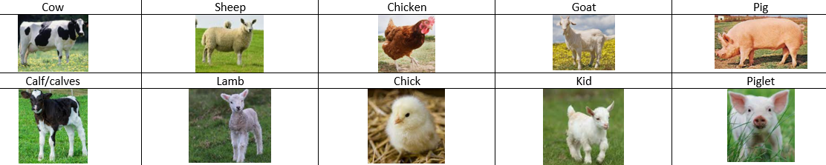
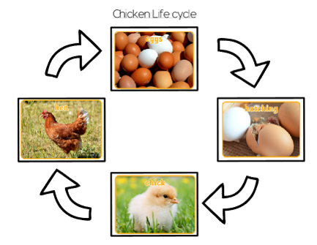
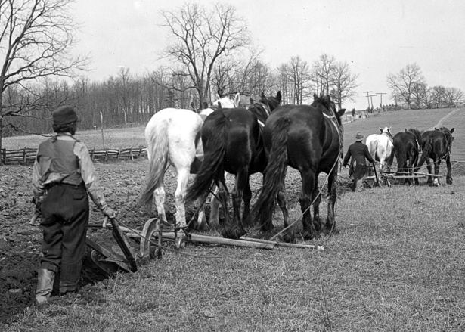
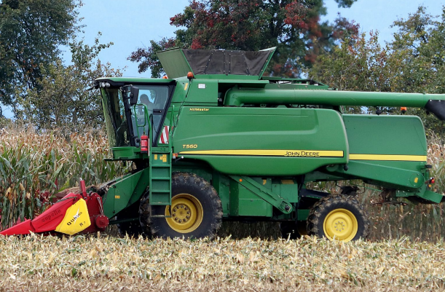
Fire Class
Summer Term 1
2025/26
Transport and the Farm
RECEPTION
Topic Overview
During this half term will finding out farms and farming methods. We will be looking at farms close to Flintham and will see how the farmers use their land. We will talk about what they grow and where different crops grow e.g. under the soil, on trees. We will look at how farming has changed over time and look at the machines that farmers use today such as combine harvesters. We will learn about the lifecycle of a chicken and discover the key differences between mammals and birds. We will also learn the name of animal babies on the farm. Then we will move onto learning about different transport and again, focus on how these have changed over time. We will also learn about London and discover some of the famous landmarks there.
Topic Timeline & Curriculum Links
Knowledge and Understanding; Farm land, Changes in farming over time, Chicken lifecycle, Mammal and birds, Animals and their babies, Our planet Earth, Light and Dark, Magnets, Floating and sinking
Expressive Arts and Design; Box model tractor, moving farm animal, drawing animals and self
Computing; E-safety and coding
PSHE; Rights and responsibilities
PE; Intro to PE
RE; A special place – At the Church
Topic Outcomes
By the end of the topic, children will have a good understanding of farms in the UK. They will be able to explain how farming equipment has changed over time. The children will be able to name farm animals and their babies, talk about the lifecycle of a chicken and different things that farmers grow. They will be able to talk about different methods of transport and again talk about how these have changed over time.
Useful Information
PE is on a Wednesday. Please send your child to school in their PE kit on this day. Please make sure earrings are removed or covered.
Forest School is for all of Fire Class on a Friday afternoon. Please send spare clothes, including sun hat, suncream, raincoat and wellies.
Please send your child’s water bottle in everyday (no juice please) along with their book bag and a coat.
Remember a sun hat and a water bottle! Please apply suncream at home where possible. We find that the 8 hour creams are the best then the children do not have to re-apply in school.
How you can help?
Update tapestry with weekend news so children can share with their peers.
Continue to log reading on Boom Reader and read their books at least 4 times a week.
Send any out of school achievements in on a Friday to celebrate in assembly e.g. swimming badges, gymnastics

