Slide 1

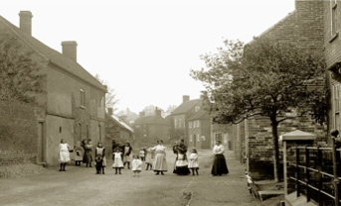
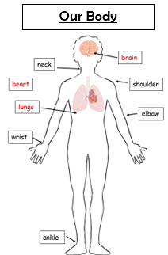
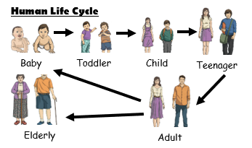
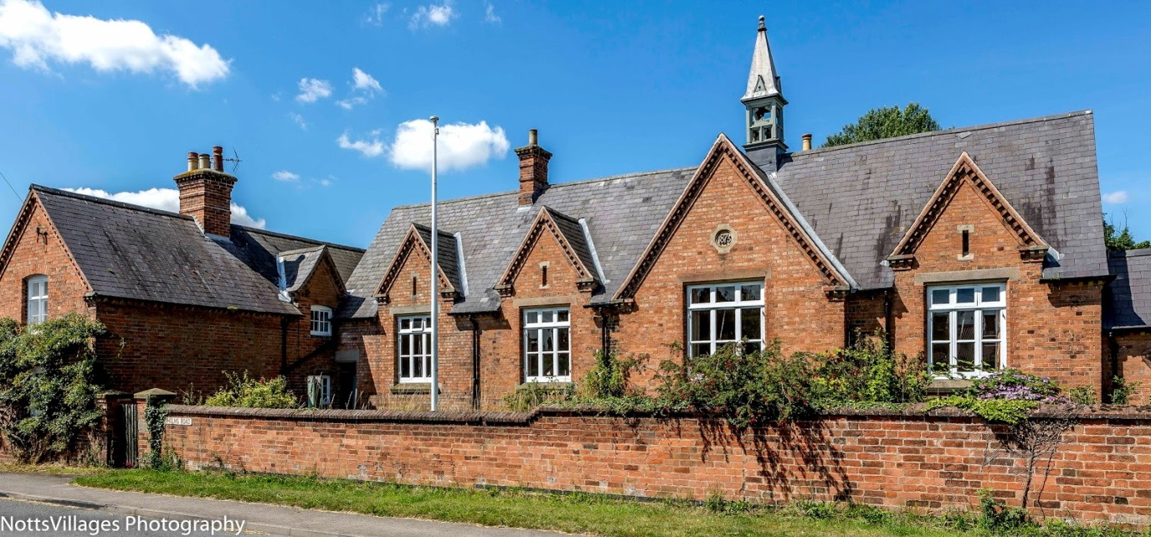
Fire Class Y1&2
Autumn Term 1 2025/26
Flintham in the Past
Finding out about life in Flintham in the Past
Topic Overview
We will be learning about Flintham village and changes that have occurred over time within the village, exploring jobs in Flintham in the past and how the village and buildings have changed or been adapted. In science we will be learning about ourselves, naming body parts and linking it to our senses. We will also be talking about human offspring and human lifecycles. We will find out the basic needs of humans and animals. We will also create our own self-portrait and explore data handling in computing. Within our English units, we will be creating our own descriptive sentences linked to a short film called Bubbles and will read Beware of the Bears, the alternative version of Goldilocks and the Three Bears. We will also read and write some autumn poetry focusing on adjectives.
Topic Information
English – Writing descriptive sentences linked to a short film, alternative versions of traditional takes, letter from Goldilocks’ point of view and autumn poetry.
Maths – Place value, calculations
Science – Ourselves (Humans)
History – Flintham in the Past
Art – Self-portraits
RE – Muslim families
Computing – Data and data handling
PE – Multiskills/fundamentals and sending and receiving. Rugby with Ben.
Music - Beat, rhythm, melody, echo, call and response, tuned and untuned percussion
Useful Information
PE is on a Wednesday and Thursday. Please make sure earrings are removed or covered and named PE kits are in school. PE may be outside so please make sure your child has plimsolls in their bag.
Please continue to read with your child at home and record on Boomreader. Reading regularly makes a huge difference to your child’s progress in school.
Forest School is for all of Fire Class on a Friday afternoon. Please send your child to school in their uniform with some old clothes to change into. their clothes. We will be outside whatever the weather so please send appropriate clothing such as waterproof/ wellies/hats/gloves. If the weather is OK, we will not change
Spelling assignments on Spelling Shed will be live for Year 1 children for the first two weeks of term and then they will focus on common exception words for the rest of the half term (see separate spellings sheet). The Year 2 children will have assignments on Spelling Shed throughout the school year.
How you can help?
Listen to your child read at least 4 times per week and log on boom reader
Read to your child to help them develop a love of reading
Help your child access and practise the Spelling Shed games and assignments
Look through the history and science knowledge organiser we have sent home with your child and help them recall the key knowledge from it, focusing also on the key vocabulary

