Slide 1

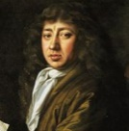
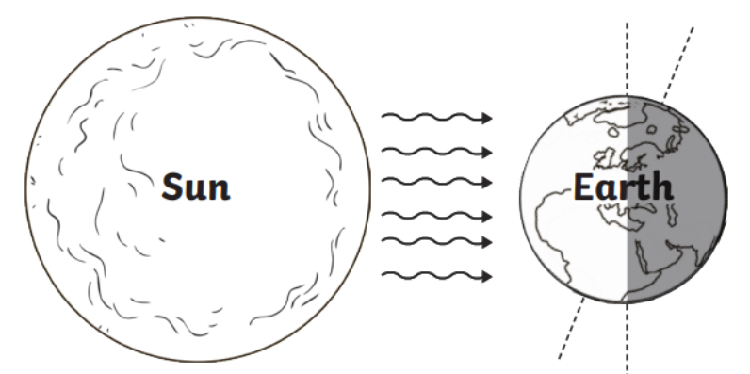
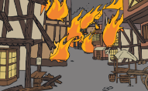

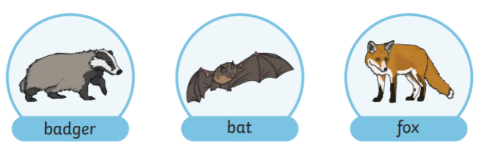
Fire Class Y1&2
Autumn Term 2 2025/26
The Great Fire of London
Finding out about the events of the Great Fire of London
Topic Overview
We will be learning about the key events of the Great Fire of London, including how the fire started, why it spread so quickly and how eye witnesses, such as Samuel Pepys, helped us to find out about life in the past.
In science we will be learning about seasonal changes, including night and day. We will observe and describe weather associated with different seasons and will find out how and why day length varies.
Our art topic will link to the Great Fire of London where we will explore colour mixing and become confident naming primary and secondary colours. We will learn how to create tints and shades by adding black or white to paint and will use these skills to create a scene inspired by the historical event.
Topic Information
English – Great Fire of London information writing, diary writing, Christmas shape poems
Maths – Place Value within 100 and Shape
Science – Night and Day/seasonal changes
History – The Great Fire of London (Events beyond living memory)
Art – Paint focus linked to the Great Fire of London
SCARF – Valuing Difference
RE – Celebrations – Eid, Christmas and Hannukah
Computing – Coding
PE – Ball skills and dance
Music – timbre, temp, dynamics, pitch, classical music, musical conversations; questions and answer and graphic score
Useful Information
PE is on a Wednesday and Thursday. Please make sure earrings are removed or covered and named PE kits are in school. PE may be outside so please make sure your child has plimsolls in their bag.
Please continue to read with your child at home and record on Boomreader. Reading regularly makes a huge difference to your child’s progress in school.
Forest School is for all of Fire Class on a Friday afternoon. Please send spare clothes, including gloves, hat and wellies in a bag.
Spelling assignments on Spelling Shed will be live for Year 1 children for the first two weeks of term and then they will focus on common exception words for the rest of the half term. The Year 2 children will have assignments on Spelling Shed throughout the school year.
How you can help?
Listen to your child read at least 4 times per week and log on Boomreader
Read to your child to help them develop a love of reading
Help your child access and practise the spelling shed games and assignments
Look through the history and science knowledge organiser we have sent home with your child and help them recall the key knowledge from it, focusing also on the key vocabulary

